Slide 1
“We Are One”: Protecting and Defending the Public Sector
Oregon AFL-CIO Summer School
Eugene, Oregon
August 6-7, 2011
Instructor:
Bob Bussel
Labor Education and Research Center
University of Oregon
bussel@uoregon.edu

Slide 2
A Light Bulb Joke about Government
Q: “How many government workers does it take to screw in a light bulb?”
A: Two. “One to screw it in and one to screw it up.”

Slide 3
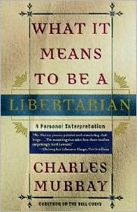
Charles Murray, on the Role of Government
“The reality of daily life is that, by and large, the things that government does tend to be ugly, rude, slovenly-and not to work.”

Slide 4
Another Image of Government

Slide 5
How Did We Get Here?

Slide 6
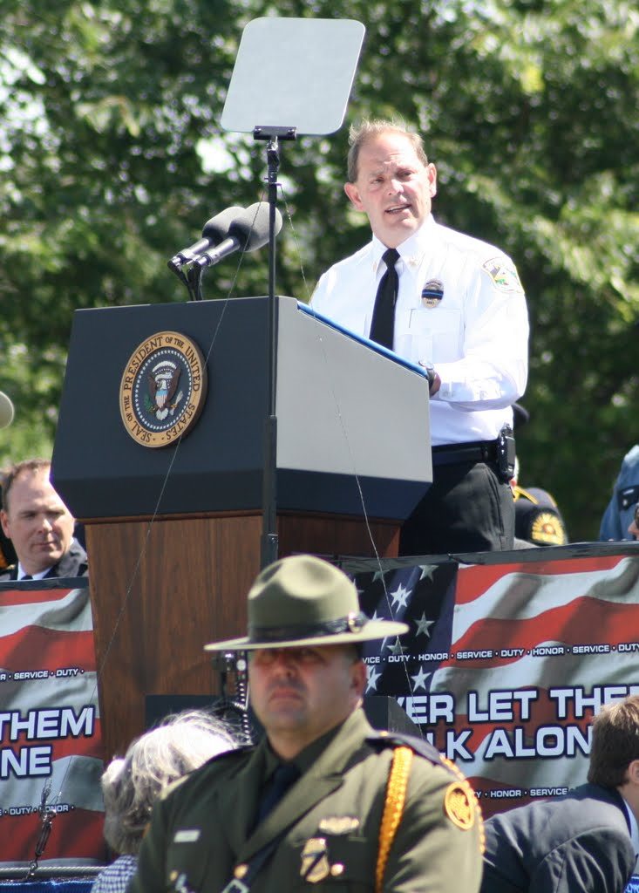
When Did Public Employees Become So Evil?
“Who are these evil teachers who teach your children, these evil policemen who protect them, these evil firemen who pull them from burning buildings? When did we all become evil?”
Chuck Canterbury,
President, Fraternal Order of Police

Slide 7
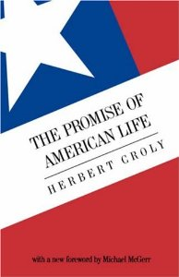
Herbert Croly on the Role of Government and Unions, 1909
“…Some individuals, and especially those artificial individuals called corporations become so very big that ordinary individuals cannot deal with them on terms of equality.”
“It therefore becomes necessary for these individuals to combine in their turn, first to act in their collective capacity through that biggest of all combinations called government and second to act also in their own self-defense, through private combinations such as farmers’ associations and trade unions.”

Slide 8
Oregon and Worker Protection Legislation
First state to make Labor Day a legal holiday, 1887.
First state to pass an enforceable wage and hour law, 1913
First state to create a Board of Conciliation and Arbitration, 1919.
Second state to establish a commission to oversee apprenticeship programs, 1931.
Sixth state to pass a Fair Employment Practices Act outlawing discrimination in employment, 1949.
First state to create a Wage Security Fund that pays workers when employers go out of business and lack assets to pay final wages, 1985.
Among first eleven states to enact a parental leave law, 1987.
Second state to place limits on captive audience meetings, 2009.

Slide 9
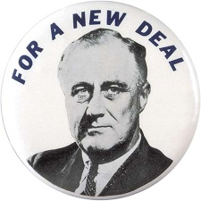
The Expansion of Government Under the New Deal
WPA
TVA
NLRA
FDIC
CCC
FLSA

Slide 10
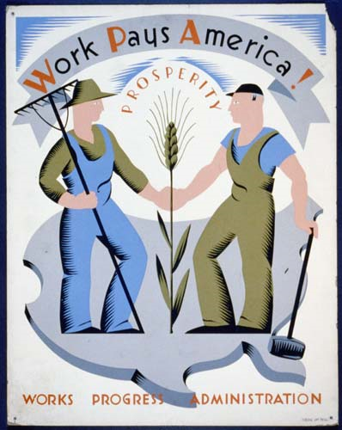
Examples of the WPA’s Accomplishments in Oregon
Timberline Lodge
Civic Stadium in Eugene
City Hall in Canby, state library in Salem, armory in Klamath Falls
Numerous post offices
Five bridges over estuaries on coast
Paved and upgraded Highway 101
Also employed teachers and artists

Slide 11
The Rise of Public Sector Unionism
Public sector union membership rises from 400,000 in 1955 to over 4 million by early 1970s
Rate of unionization of government employees rises from 13% in 1960 to 39% in 1976
AFSCME goes from 19th largest union in AFL-CIO to 6th largest between 1960 and 1970.
From 36 public sector strikes in 1960 to 412 in 1970

Slide 12
The Thirty Years War on Unions
Attacks on the building trades (1970s)
Firing of the air traffic controllers (1981)
“Concession bargaining” (1980s)
Growing demands for contracting out
Gutting the right to organize
Rise of right-wing think tanks

Slide 13
A Tale of Three Percentages: What Do These Figures Refer to?
6.9%
36.2%
11.9%

Slide 14
They’ve Run Away “GE Brings Good Things to Life” (in China)
Since 2002, GE has eliminated 20% of its US work force while increasing employment overseas.
In 2010, GE paid no federal taxes on $14.2 billion in profits.
Corporate taxes in 2009 comprised 6.6% of federal revenue, down from 30% in the 1950s.

Slide 15
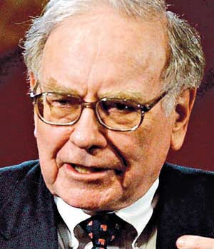
Warren Buffet, Annual Letter to Shareholders, 2004
“If class war is
being waged in
America, my class
is clearly winning.”

Slide 16
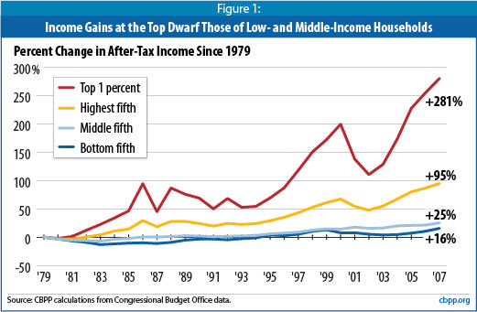
“Of the 1%, By the 1%, For the 1%”: The Haves, The Have-Nots, and the Have-Mores

Slide 17
Grover Norquist, on “Starving the Beast”
"I don't want to abolish government. I simply want to reduce it to the size where I can drag it into the bathroom and drown it in the bathtub.”

Slide 18
Tax Reform and Oregon Schools
1990—Measure 5
•Capped property tax rates, then lowered them to $5 per $1000 over 5 years.
•Shifted responsibility for the shortfall from local school districts to the state
1992—Alternative Tax Reforms Fail
•“Split Role” amendment to Measure 5
• Education dedicated sales tax
1996/97—Measure 47 and 50
•Capped increases in property assessments at 3% per year
•Required double majority for most local tax measures

Slide 19
School Funding from 1997-Present
2000—Ballot Measure 1 requires equitable state support of schools
•Ballot Measure 86 puts the “Kicker” in the State Constitution
•By 2000 state contributions to local schools has risen from 28% to 70%
2009—Greatest recession since the Great Depression results in losses of $4.2Billion to the States General Fund
2010—BM 66 & 67 increase individual and corporate income tax rates

Slide 20
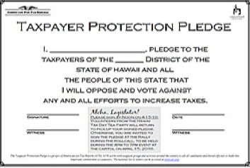
Taking the Pledge to “Starve the Beast”

Slide 21
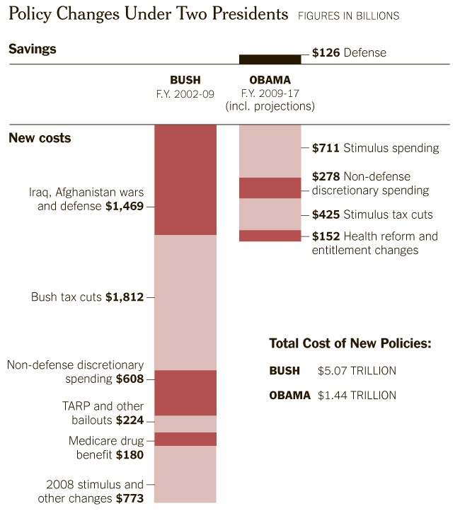
How the Debt Got So Big Teresa Tritch, New York Times, July 24, 2011

Slide 22
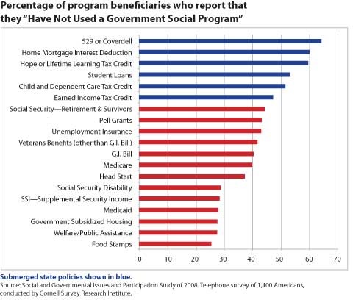
“The Submerged State”

Slide 23
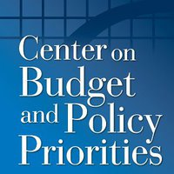
Jon Shure, Center on Budget and Policy Priorities, on Tax Cutting During Hard Times
“To be cutting taxes when you’re short of revenue is like saying you could run faster if you cut off your foot.”

Slide 24
An Introduction to Framing

Slide 25
The “Job-Killing” Frame (I)

Slide 26
Oregonians Against Job-Killing Taxes Signature Gathering Training Do’s and Don’ts
Presented By
Andrew Over, Oregon GOP
Ross Day
VOTE Oregon LLC

Slide 27
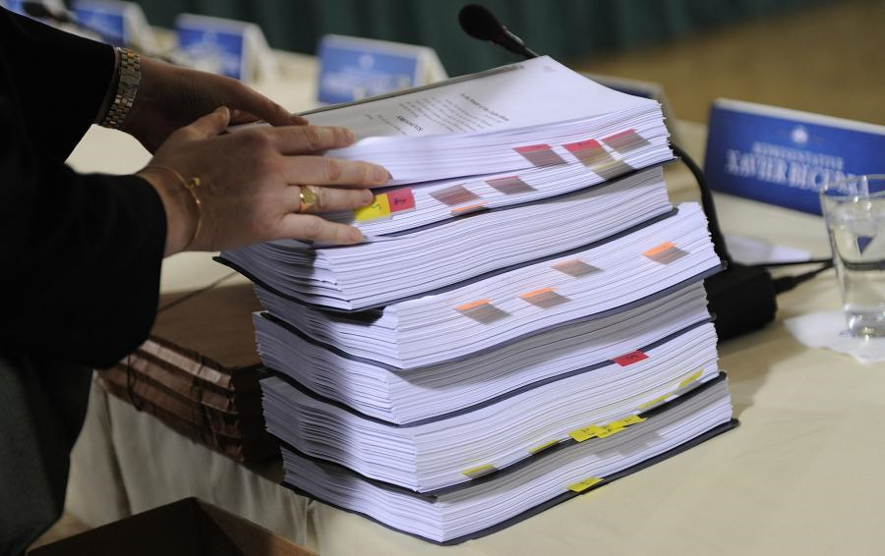
Pictures Frame the Story (I): The Battle Over Health Care Reform

Slide 28
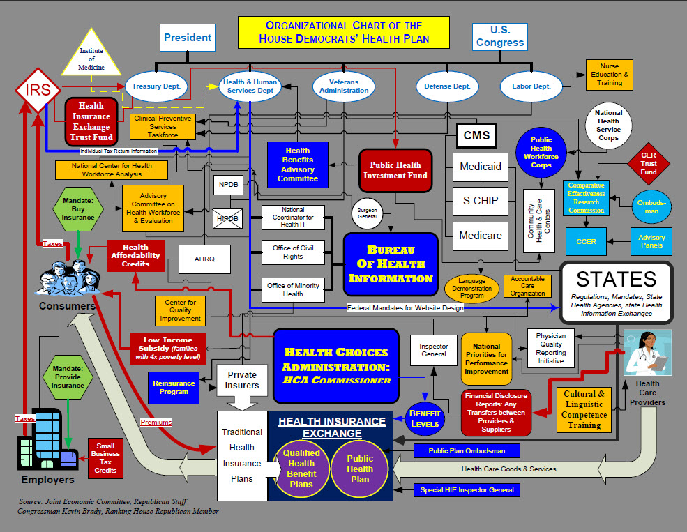
Pictures Frame the Story (II): The Battle Over Health Care Reform

Slide 29
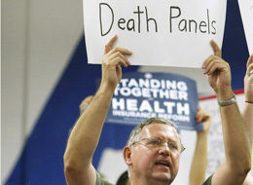
“Death” as a Frame (I)

Slide 30
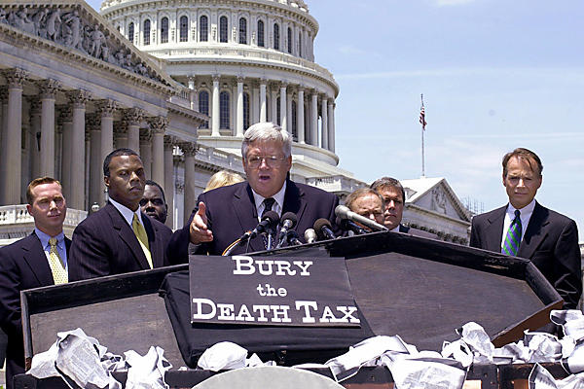
Death as a Frame (II)

Slide 31
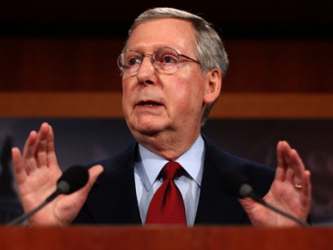
Framing the Debt Ceiling “Crisis”: Senate Minority Leader Mitch McConnell, August 2, 2011
“Those of us who’d been fighting big-government policies”
“The spending spree may actually be coming to an end.”
“It doesn’t include a dime in job-killing tax hikes…”
“It’s a crucial step toward fiscal sanity.”
“Slowing down the big-government freight train”

Slide 32
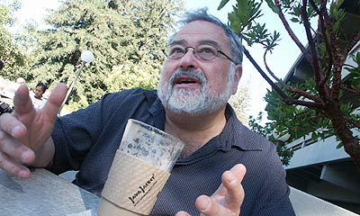
George Lakoff on Framing
“The truth alone will not set you free. It has to be reframed correctly.”

Slide 33
Lakoff on Why the Political Right’s Framing Has Been Successful
“All politics is moral. The reason: voters identify themselves as moral beings, not policy wonks.”

Slide 34
Values Defined
“Basic beliefs, principles, or convictions that guide the behavior of individuals or organizations”

Slide 35
“Their Story:” The Political Right’s Case Against the Public Sector and Public Employees

Slide 36
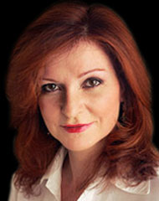
Maureen Dowd, New York Times, July 31, 2011
“What if the people who hate government are good at it and the people who love government are bad at it?

Slide 37
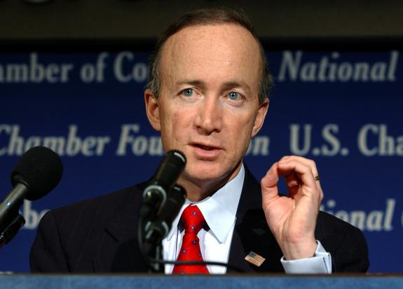
“With the Stroke of a Pen”: Public Employee Collective Bargaining Rescinded in Missouri and Indiana, 2005

Slide 38
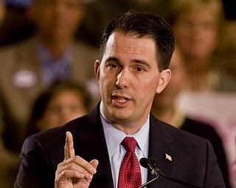
Scott Walker, Republican Governors Conference, November 2010
“We cannot and should not maintain a system where public employees are the haves and the taxpayers footing the bill are the have-nots.”

Slide 39
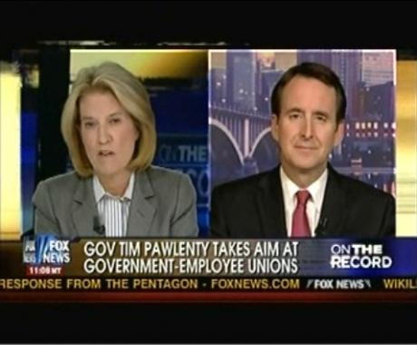
Tim Pawlenty, (I) “Government Unions vs. Taxpayers” December 2010
“The moral case for unions—protecting working families from exploitation—does not apply to public employment. Government employees today are among the most protected, well-paid employees in the country. Ironically, public-sector unions have become the exploiters, and working families once again need someone to stand up for them.”

Slide 40
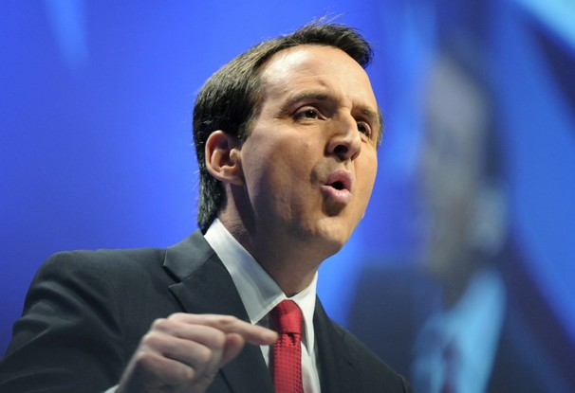
Tim Pawlenty on Public Employees (II)
“How did this happen?
Very quietly. The rise of government unions has been like a silent coup, an inside job engineered by self-interested politicians and fueled by campaign contributions.”

Slide 41
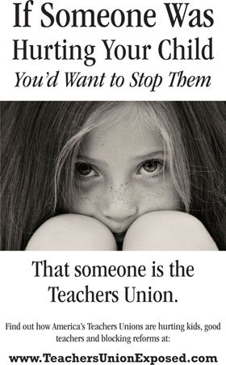
Taking on Teachers

Slide 42
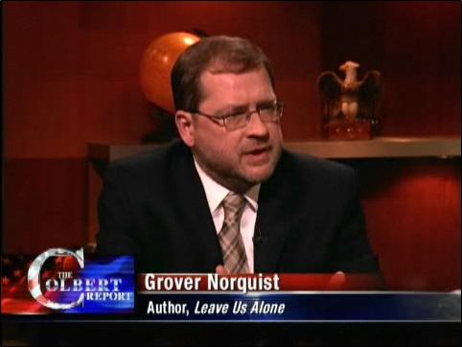
How Grover Norquist and the Right Wing Frame Unions
“Unions no longer represent the best interests of their workers.
“Increasingly, unions are little more than agitators for big government. When the majority of union members come from the beehive cubicles of government bureaucracy, it doesn’t take a genius to figure out that higher taxes, more government, and more dues-paying bureaucrats are good for increasingly desperate union bosses.”

Slide 43
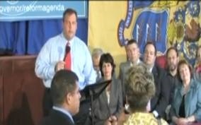
New Jersey Governor Chris Christie “Takes Down” a NJ Teacher
“I love teachers.
I just can’t stand your union.”

Slide 44
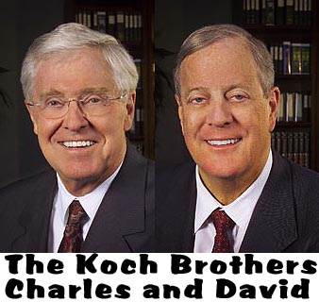
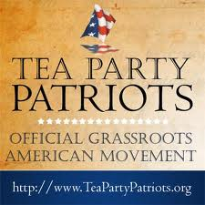
“Things Don’t Go Better with [the] Koch Brothers”

Slide 45
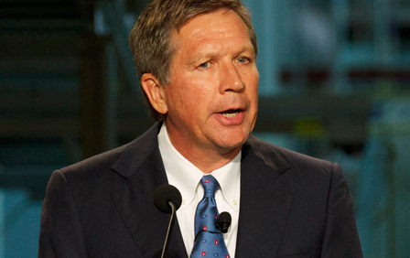
“Privatize This”: Ohio’s New Collective Bargaining Law
Collective bargaining agreements cannot prohibit the following:
Privatization or subcontracting to another public employer
Requiring retention of existing employees if their work is privatized or subcontracted
Requiring payment of any additional compensation upon layoff due to privatization except for accumulated time or leave credits

Slide 46
Coming Soon to a Legislature Near You
Oregon HB 3484
(introduced in 2011 Session)
“Establishes Council on Efficient Government. Directs council to review whether goods or services provided by state agencies should be privatized, review solicitations for public contracts, issue annual report and create inventory of activities of state agencies to determine whether activities are inherently governmental activities or activities that could be performed by private entity.”

Slide 47
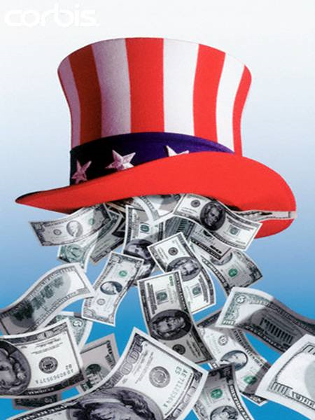
Campaign Spending: By What Ratio did Business Outspend Labor in the 2010 Election Cycle?
3-1
10-1
15-1
25-1

Slide 48
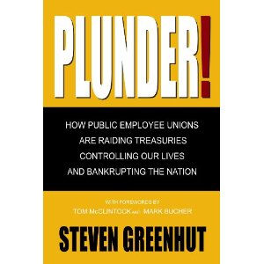

Slide 49
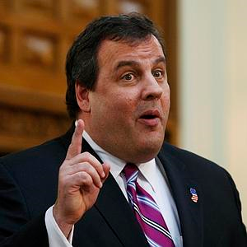
New Jersey Governor Chris Christie on Public Sector Collective Bargaining
"Listen, all these rights are legislatively created. They didn't come down from tablets at the top of a mountain. So political things change and go back and forth. Every state is going to make their own determination on that."

Slide 50
Public Opinion: Good News and Bad News
By a 60% to 33% margin, Americans opposed taking away collective bargaining rights for public employees (7% had no opinion).
However, 37% believe unions have too much influence on American life and politics (19% thought “too little, 29 % thought the “right amount,” and 15% had no opinion).
NY Times/CBS Poll, February 2011

Slide 51
The Steve Buck Problem Letter on EWEB strike
“I’d like to be the first to welcome Mark Hankins and all EWEB union
employees to the 21st century work world.”
“It’s a world where many employees are glad to have one paid
holiday, much less 10 or 11. Where many people receive little or no
help from their employers with health care and spend thousands of
dollars out of their own pockets trying to keep their families healthy.
And, believe it or not, it’s a world where many employees work
without contracts without the generous salaries, security, and benefits
that EWEB employees enjoy.”
“Welcome to the world that the rest of us work in every day.”

Slide 52
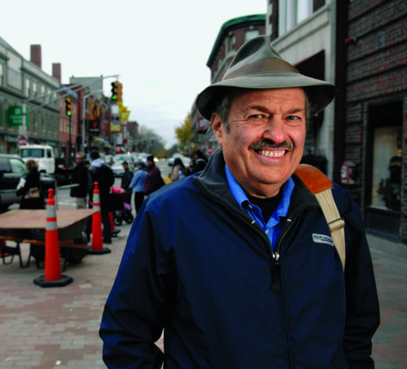
Harvard Economist Richard Freeman, on Public Hostility Toward Unions
“It shows hopelessness. It used to be, ‘you have something I don’t have; I’ll go to my employer to get it, too.’ Now I don’t see any chance of getting it, too. I don’t want to be the lowest one on the totem pole, so I don’t want you to have it either.”

Slide 53
Telling Our Story: Reframing the Discussion

Slide 54
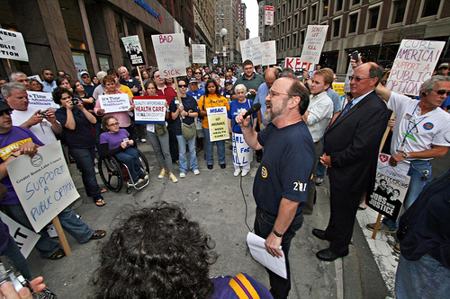
The Need to Change Perceptions of Public Employees and the Public Sector Jeff Crosby, President North Shore Labor Council (MA)
“Either we change the public perception of government-equating the public sector with the public good each time we speak- or we lose public jobs and services. And that hurts us all.”

Slide 55
Re-telling Our Story: Proud to Be OSEA
Helping Students Get Scholarships
“I give my personal phone number to dozens of kids… For many students I am the only adult who has the time to review applications. Many have no idea of the opportunities they have available to them.”

Slide 56
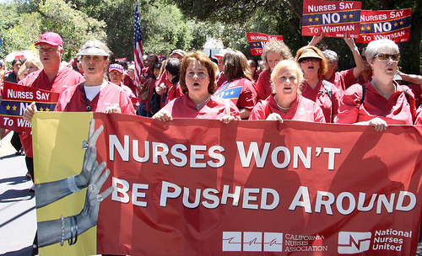
Union Leaders, Members, and the 2010 California Governor’s Race
"Californians love nurses, teachers and firefighters, but they hate the unions that these folks belong to." "If it's Meg vs. nurses, teachers and firefighters, she loses. [But] if it's Meg vs. the union bosses, she wins.“
Jack Pitney, professor at Claremont McKenna College and a former GOP official

Slide 57
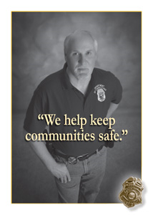
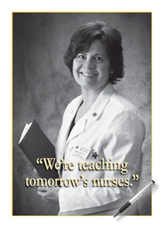
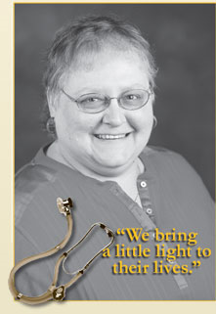
Work That Matters: Montana Union Members Tell Their Stories

Slide 58
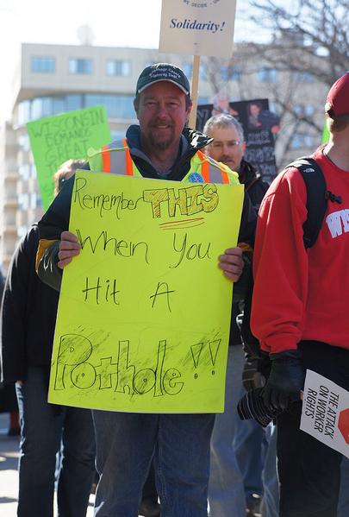
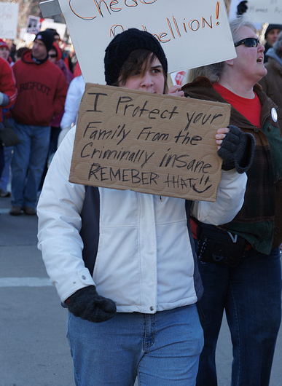
Images from Wisconsin

Slide 59
Community Outreach 101

Slide 60
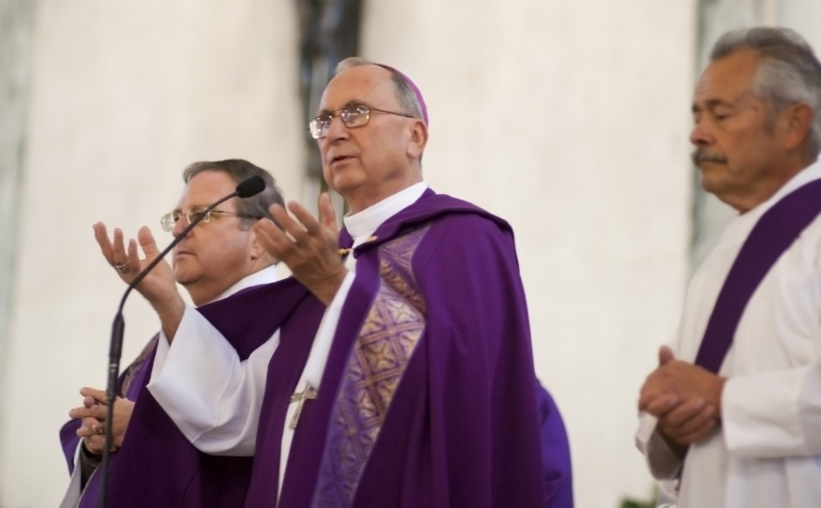
Bishop Stephen Blaire, chairman of the U.S. Bishops' Committee on Domestic Justice, on events in Wisconsin
"The debates over worker representation and collective bargaining are not simply matters of ideology or power," "but involve principles of justice, participation, and how workers can have a voice in the workplace and economy."

Slide 61
Reaching Out Beyond the “Usual Suspects”
Faith community
Veterans’ groups
Local businesses
Rotary Clubs
Senior citizens’ groups
Women’s organizations
United Way
Neighborhood associations

