Slide 1
“Neither New Nor Normal”: The Politics of Economic Injustice and the Roots of Union Renewal
Oregon Education Association
“Powerful Locals First Convocation”
Lane Community College Eugene, Oregon
December 7, 2012
Bob Bussel Labor Education and Research Center University of Oregon
bussel@uoregon.edu

Slide 2
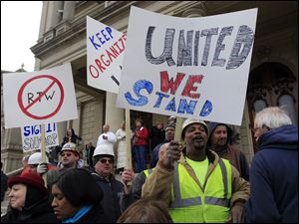
“The Empire Strikes Back”: Right-to-Work in Michigan

Slide 3
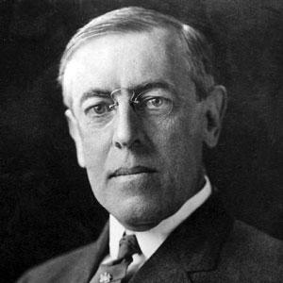
Woodrow Wilson on the “Labor Question,” 1919
“The question which stands at the front of all others amidst the present, great awakening is the question of labor.”
“How are the men and women who do the daily labor of the world to obtain progressive improvement in the conditions of their labor, to be made happier, and to be served better by the communities and the industries which their labor sustains and advances?”

Slide 4
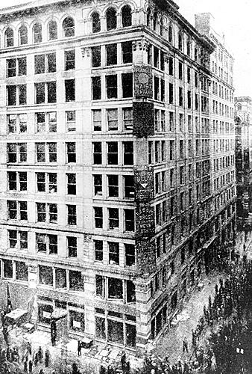
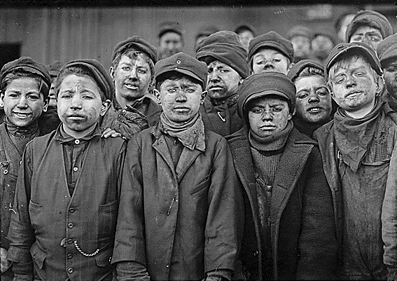
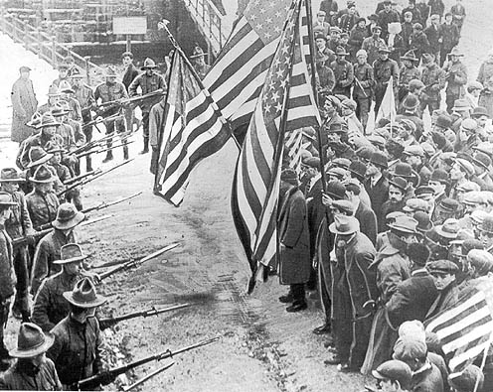
“How the Other Half Lived”: Workers a Century Ago

Slide 5
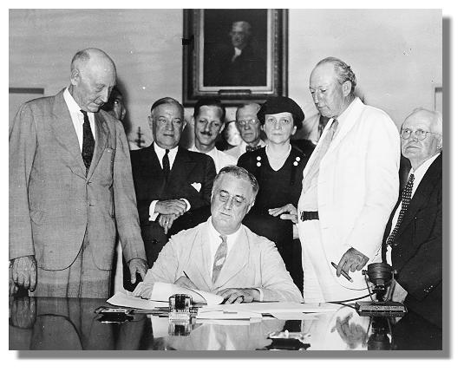
Collective Bargaining as a Public Good: The National Labor Relations Act
“Experience has proved that
protection by law of the right of
employees to organize and
bargain collectively safeguards
and promotes the flow of
commerce… by restoring
equality of bargaining power between
employers and employees.”

Slide 6
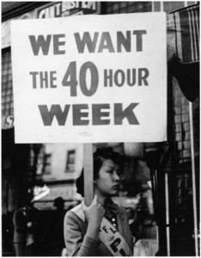
The Emergence of “Moral Capitalism”: Franklin Roosevelt, Introducing the Fair Labor Standards Act, May 1937
"A self-supporting and self-respecting democracy can plead no justification for the existence of child labor, no economic reason for chiseling worker's wages, or stretching workers' hours.“
“[Goods produced under] conditions that do not meet rudimentary standards of decency should be regarded as contraband and ought not to be allowed to pollute the channels of interstate trade."

Slide 7
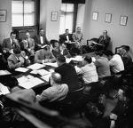
The Best Years of Our Lives: Unions Create a New Middle Class
Workers covered by private pensions rise from 3.8 million in 1940 to 15.2 million in 1956.
Workers covered by health insurance rise from 6 million in 1939 to 91 million by 1952.
Real earnings for production workers increase by 41% from late 1940s through late 1960s.
Lichtenstein, State of the Unions, Zieger and Gall, American Workers, American Unions, Phillips-Fein, Invisible Hands

Slide 8
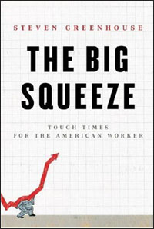
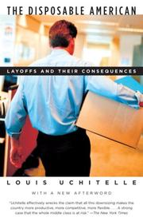
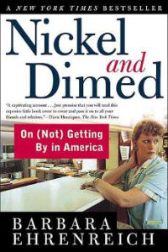
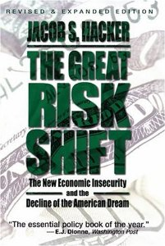
Back to the Future: The Labor Question in the 21st Century

Slide 9
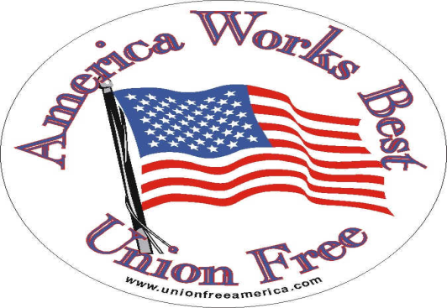
First, They Came for the Private Sector: The “Thirty Years War” on Unions
Attacks on the building trades (1970s)
Firing of the air traffic controllers (1981)
“Concession bargaining” (1980s)
Gutting the right to organize (ongoing)
Rise of right-wing think tanks (since 1970s)

Slide 10
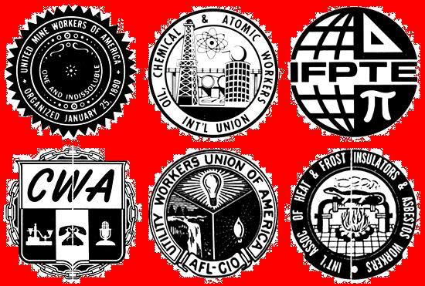
A Tale of Three Percentages: What Do These Figures Refer to?
6.9%
37%
11.8%
Private Sector
Public Sector
Total Labor Force
Percentages of Workers Who Are Union Members (2011)
Source: Bureau of Labor Statistics

Slide 11
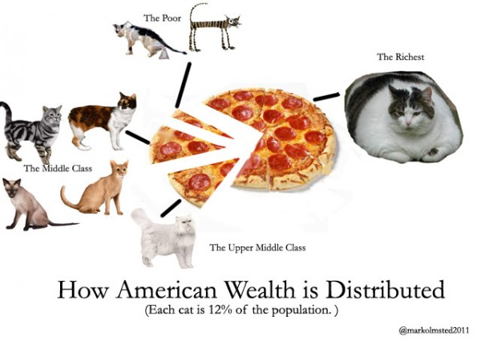
Cats and Pizza: The Distribution of Wealth in America

Slide 12
A “Human Census”
Please stand up if you know:
Someone who has lost a job
Someone who has lost their home or is facing foreclosure
Someone who took a pay or benefit cut
Someone who suffered losses in their savings or pension

Slide 13
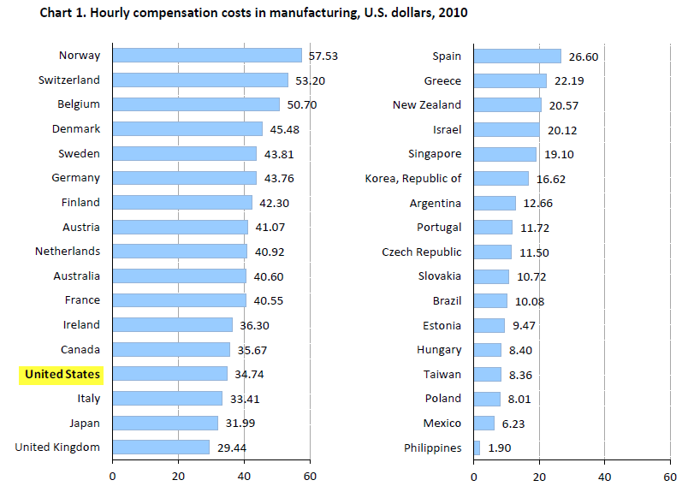
Manufacturing Compensation of Selected Countries, 2010 US Bureau of Labor Statistics

Slide 14
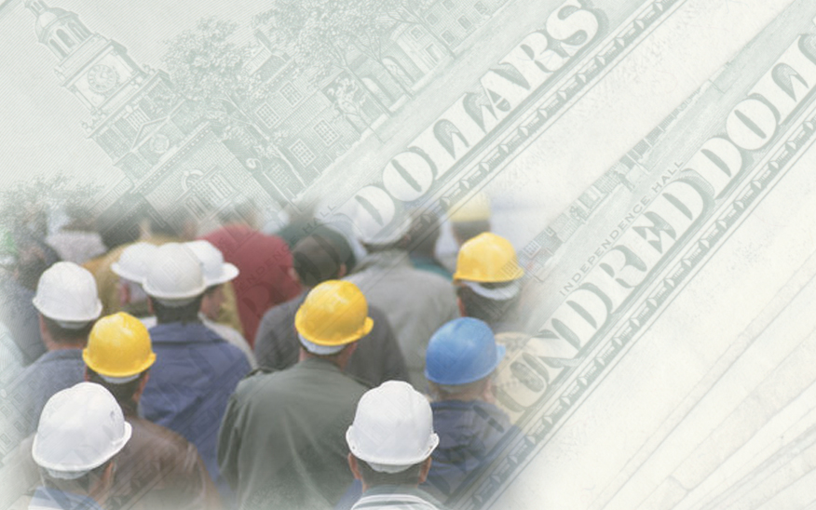
We Make It – They Take It Productivity vs. Wage Growth
2.0
Productivity
Wages
1.5
1.0
0.5
1947
1950
1960
1970
1980
1990
2000
2006
Source: Economic Policy Institute
Notes:
The key to understanding the stagnation of family incomes and wages is the rupture of the crucial relationship between productivity and wage growth.
[Click] Looking again at the period from 1947 to 1973 we can see that productivity doubled and so did the real value of average wages.
[Click] However, since 1973, although productivity has continued to grow, wages have stagnated. As a result, average wages today are only 15 percent higher than average wages in 1980, despite a 67 percent increase in productivity.
The productivity-wage relationship was the foundation of a social contract negotiated between labor and employers after World War II – on the basis of a rough balance of power – that assured that workers would share in the benefits of economic growth. Today, the imbalance of power has ruptured that relationship and the social contract with America’s workers is being shredded.
Working families are not only struggling to make ends meet on stagnant earnings, they are, most of all, concerned about the future of their children. They are anxious about their ability to retire and fearful of what a serious accident or sickness might mean for their family’s economic security. And, they are increasingly angry about the sheer injustice of our country’s growing inequality.

Slide 15
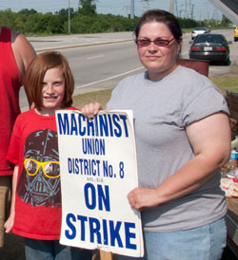
Whatever Happened to Shared Prosperity? The Machinists at Caterpillar
“Despite earning a record $4.9 billion profit last year and projecting even better results for 2012, the company is insisting on a six-year wage freeze and a pension freeze for most of the 780 production workers at its factory here. Caterpillar says it needs to keep its labor costs down to ensure its future competitiveness.”
New York Times, July 2012

Slide 16
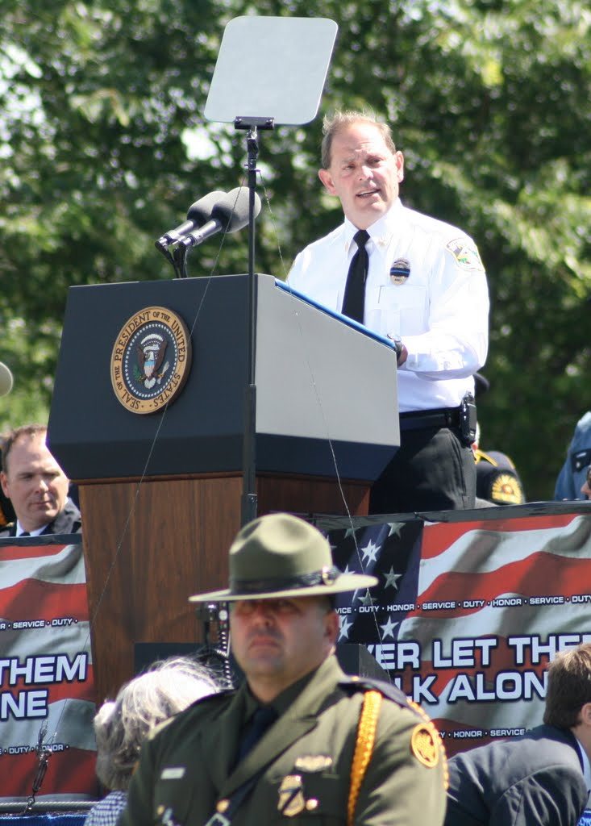
Then They Came for the Public Sector
“Who are these evil teachers who teach your children, these evil policemen who protect them, these evil firemen who pull them from burning buildings? When did we all become evil?”
Chuck Canterbury,
President, Fraternal Order of Police

Slide 17
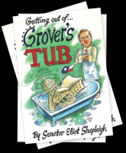
Becoming Evil: Grover Norquist, on “Starving the Beast”
"I don't want to abolish government. I simply want to reduce it to the size where I can drag it into the bathroom and drown it in the bathtub.”

Slide 18
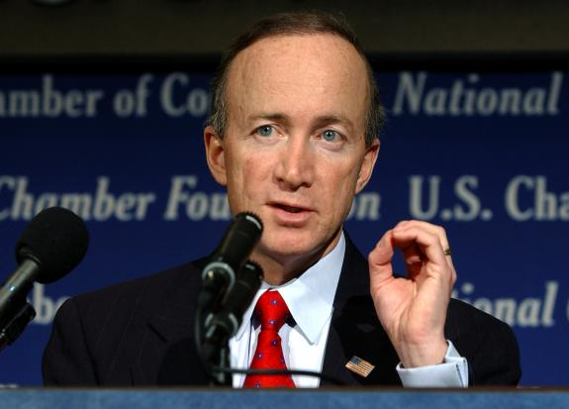
Becoming Evil: Scapegoating the Public Sector
“We have a new privileged class in America. We used to think of government workers as underpaid public servants. Now they are better paid than the people who pay their salaries.”
Former Indiana Governor
Mitch Daniels

Slide 19
Pitting the Public Against Public Employees Che Ryan, letter to editor, Register Guard, August 2012
“Other than the very wealthy, public employees are the only folks who largely have been unaffected by the economic downturn. They continue to receive fat pensions, regular raises, and excellent medical benefits of which the rest of us can only dream.”
“My job went to Bangalore, India, two years ago, and since then I have scraped by with part-time work and no medical benefits. And still those who feed at the public trough want more money.”

Slide 20
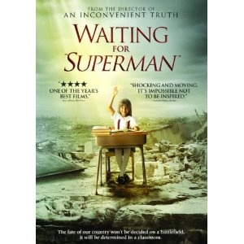
From Heroes to Villains: Teachers and Teacher Unions in the Movies

Slide 21
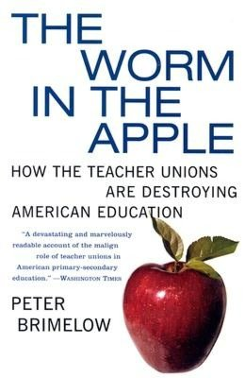
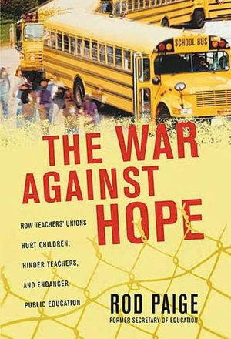
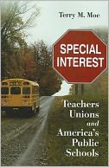
Demonizing Teachers’ Unions

Slide 22
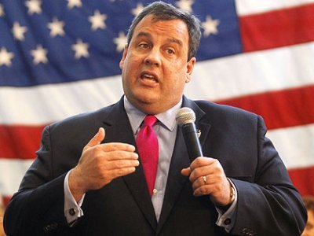
“Loving” Teachers, Hating Unions
“I love teachers.
I just can’t stand your union.”
New Jersey Governor Chris Christie

Slide 23
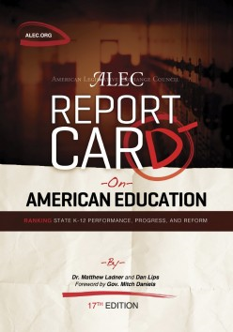
ALEC’s Strategy to Undermine Public Education
“Transform the system, don’t tweak it. Like a game of Whack-a-Mole, introduce so many pieces of model legislation that there is no way the person with the mallet [teachers’ unions] can get them all.”
Julie Underwood, The Nation, 8/2011

Slide 24
Whack-a-Mole at Work:” Attacks on Teachers and Public Education
Vouchers
Charter Schools
Tenure
Seniority
Collective Bargaining
Parent Trigger Laws
Testing

Slide 25
“Fighting the Stress of Teaching to the Test” Stephenie Overman, NEA Website
“I know, I know. Eat healthy, sleep, exercise. I can do that if I'm working a 40 hour week... but I put in so much overtime, just to stay afloat, that I have to go to bed late just to fit it all in. Then I'm tired, then I'm more stressed. It all is a cycle and what needs to stop is adding more and more to our plates.”
“Nicole,” a teacher commenting on Overman’s article

Slide 26
Roots of Renewal and Taking Back Your Profession: What Powerful Locals Can Do
Mobilize teachers and make them a highly visible presence in their communities
Reframe the public conversation by telling a different story rooted in our perspective and values
Build strong alliances that defend public education and place teachers at the forefront of true education reform
Lead a coalition of conscience that makes the “labor question” a social priority

Slide 27
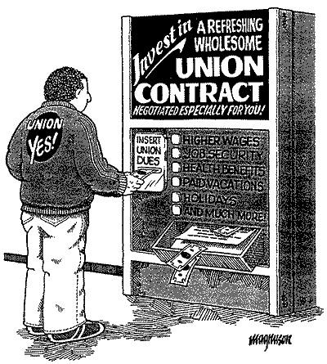
Unionism Can No Longer Be a Spectator Sport

Slide 28
A Generation Gap? Attitudes about Unions Among Teachers Education Sector, 2011
Veterans
(more than 20 years)
Newcomers
(less than 5 years)
“Unions are essential”
“Very or somewhat involved in union”
“Being a union member provides feelings of pride and solidarity, as well as practical benefits”
35% 52%
20% 46%
22% 49%

Slide 29
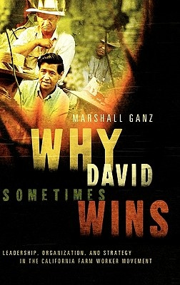
Telling Your Own Story
“When you do public work, you have a responsibility to offer a public account of who you are and what you hope to do… If you don’t author your own story, others will, and they may not tell it in the way you like.”
Marshall Ganz, pioneering UFW organizer and lecturer, Kennedy School of Government

Slide 30
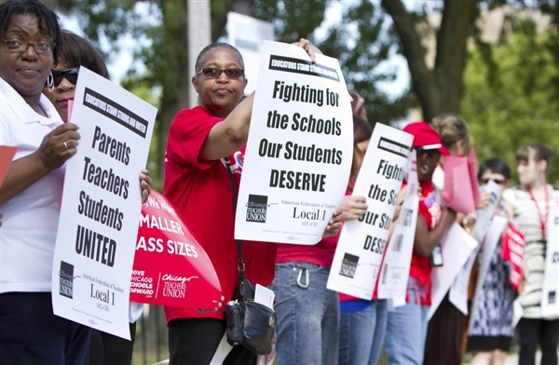
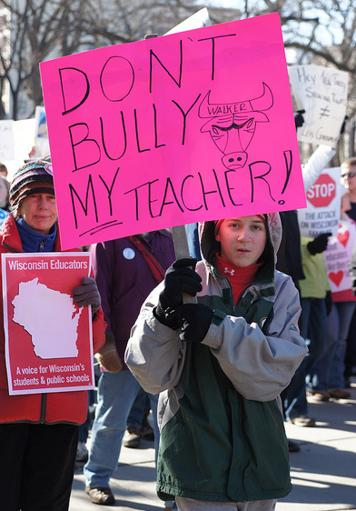
Taking It to the Streets: Building a New Coalition of Conscience

Slide 31
Retirement Security
Health Care
Strong Public Services
Ladder of Opportunity
Good Wages
Strong Unions
Education

Slide 32
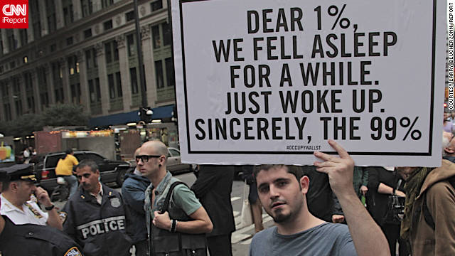
And It Will Take A Movement

