Slide 1
Growth of Inequality
Labor and Working-Class History Association
Do not distribute

Slide 2
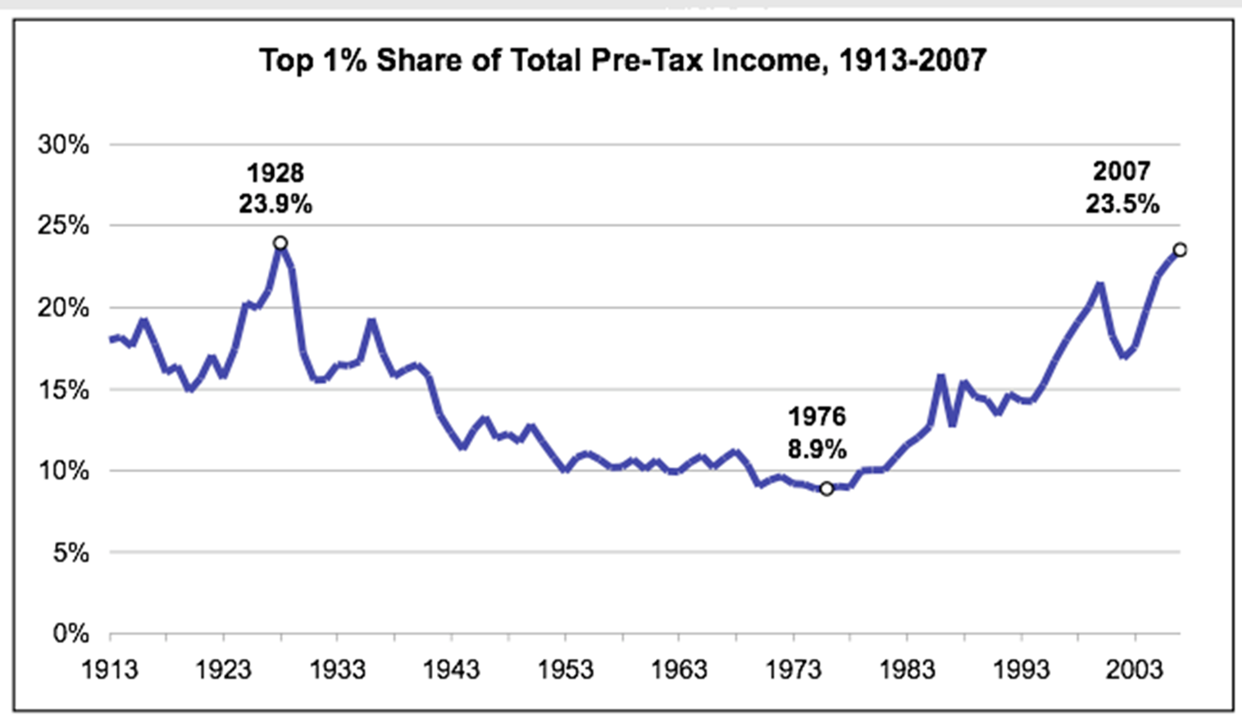
Notes:
Source: Thomas Piketty and Emmanuel Saez, "Income Inequality in the United States, 1913-1998," Quarterly Journal of Economics, 118(1), 2003. Updated to 2005 at http://emlab.berkeley.edu/users/saez

Slide 3
Total Income Going to Top 1%
1977 – 8%
2007 – 23.5%
Saez & Piketty “Evolution of Top Incomes: A Historical and International Perspective”

Slide 4
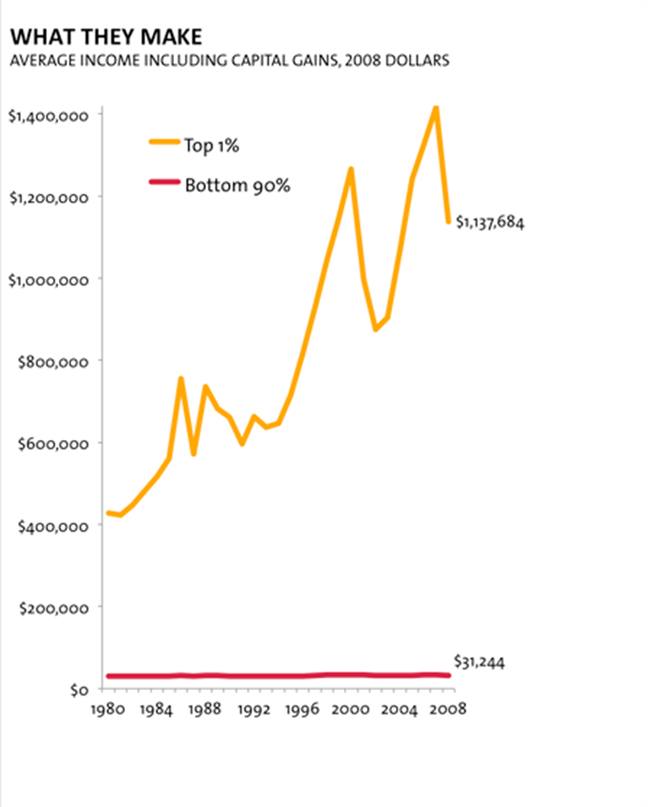
Notes:
Source: http://www.motherjones.com/mojo/2011/10/one-percent-income-inequality-OWS

Slide 5
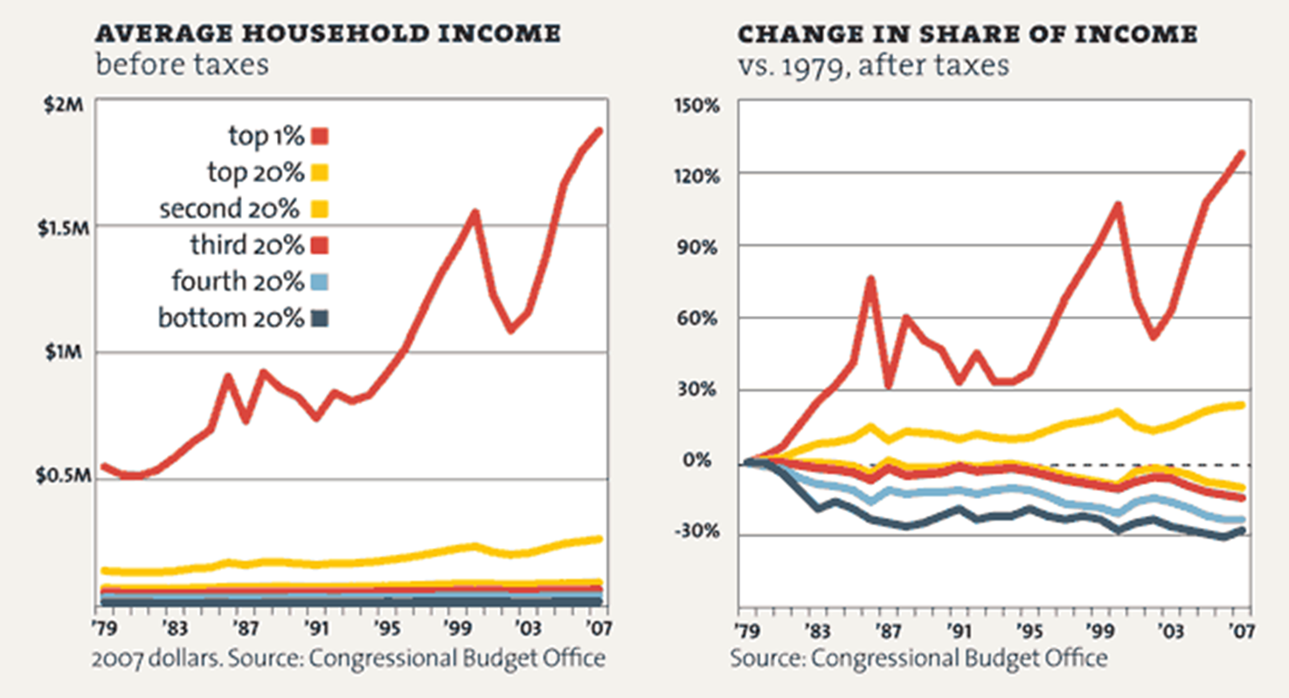

Slide 6
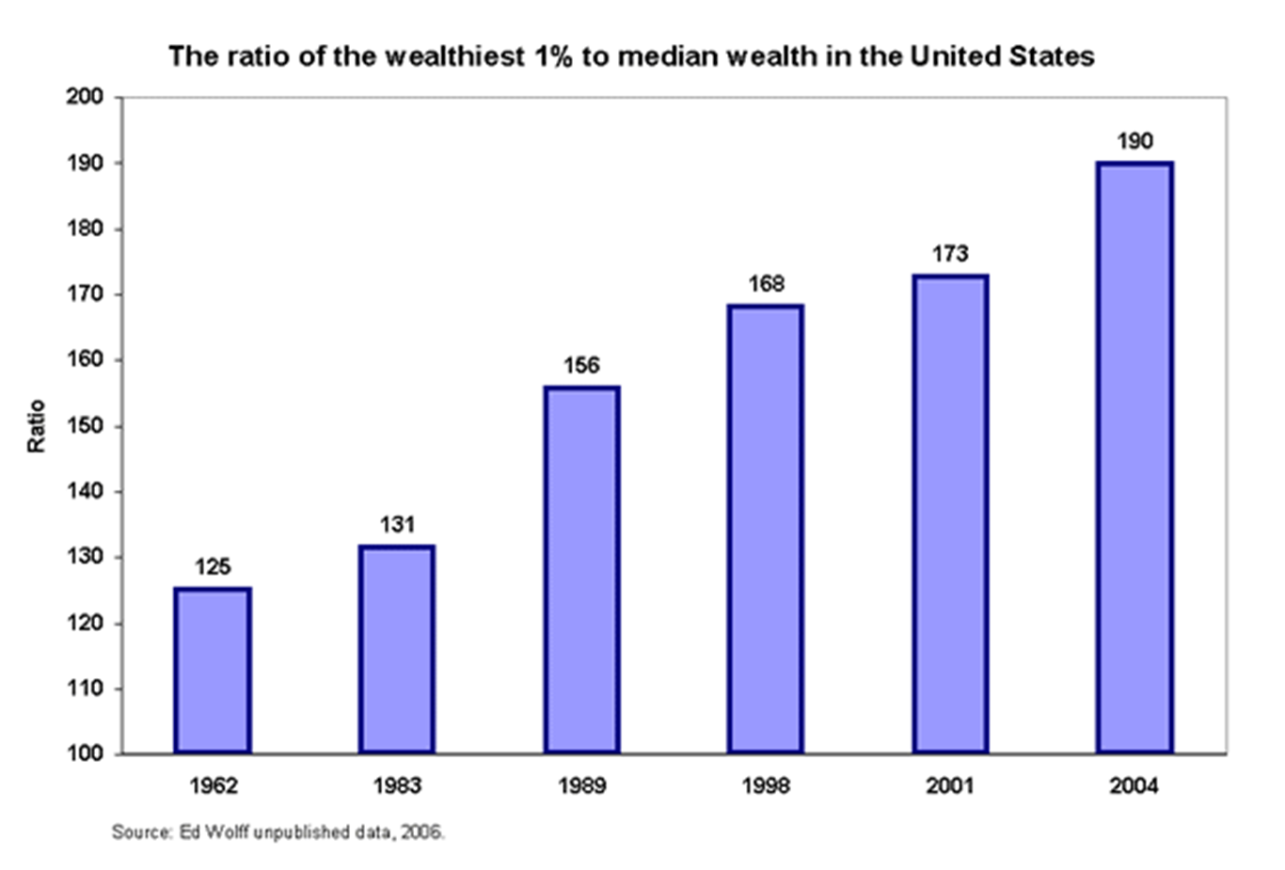
Notes:
The figure is one such measure of inequality—the ratio of the wealth of the richest 1% to that of a household with typical wealth in the middle. As the figure indicates, wealth inequality has not only persisted, but also grown much larger over time. The richest 1% of wealth holders had 125 times the wealth of the typical household in 1962; by 2004 they had 190 times as much or $14.8 million in wealth for the upper 1% compared to just $82,000 for the household in the middle fifth of wealth. http://www.epi.org/economic_snapshots/entry/webfeatures_snapshots_20060823/

Slide 7
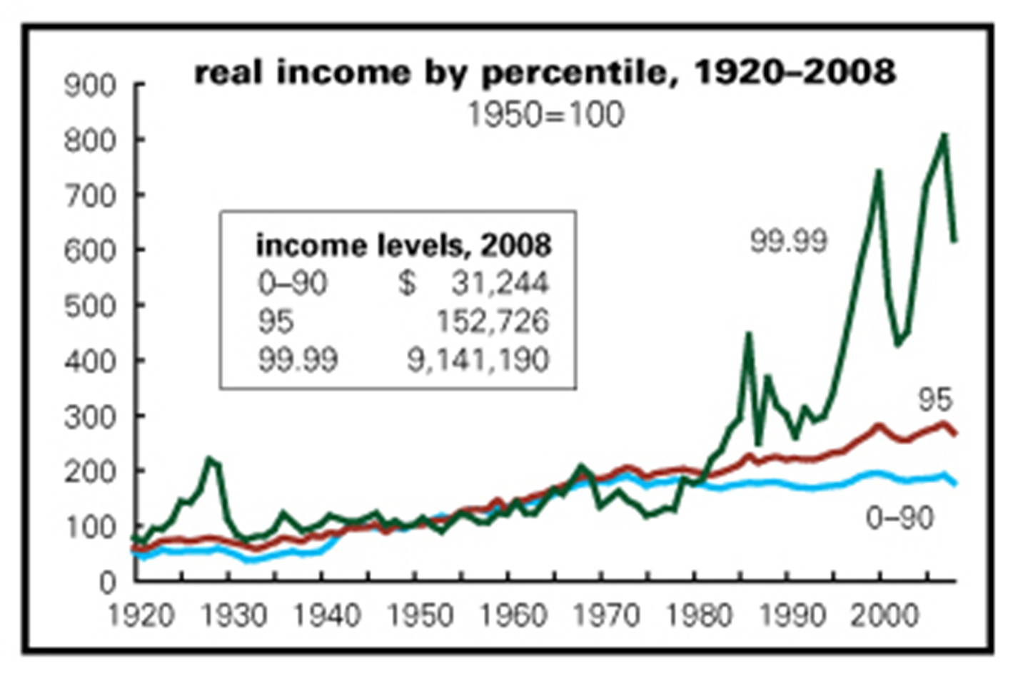
Notes:
To take a broader look, the graph above shows Thomas Piketty and Emmanuel Saez's data on average inflation-adjusted incomes for the bottom 90% of the population, income at the 95th percentile (the level that's richer than 94% of the population), and at the 99.99th percentile (the richest 0.01%). (The familiar annual Census Bureau numbers are based on a large survey of households that inevitably misses the rich; the Piketty–Saez data come from tax returns. Since the rich are quite skilled at evading taxes, their figures probably understate life at the top.) From the early 1930s through the late 1960s, the incomes of the masses and the rich grew more or less in tandem. Then, tragically, growth at the high end began seriously to lag the broader population. While the incomes of the bottom 90% (by the Piketty–Saez measure fell by 2% from 1968 to 1978, those of the top 0.01% were down by 38%. This was clearly a social emergency.

Slide 8
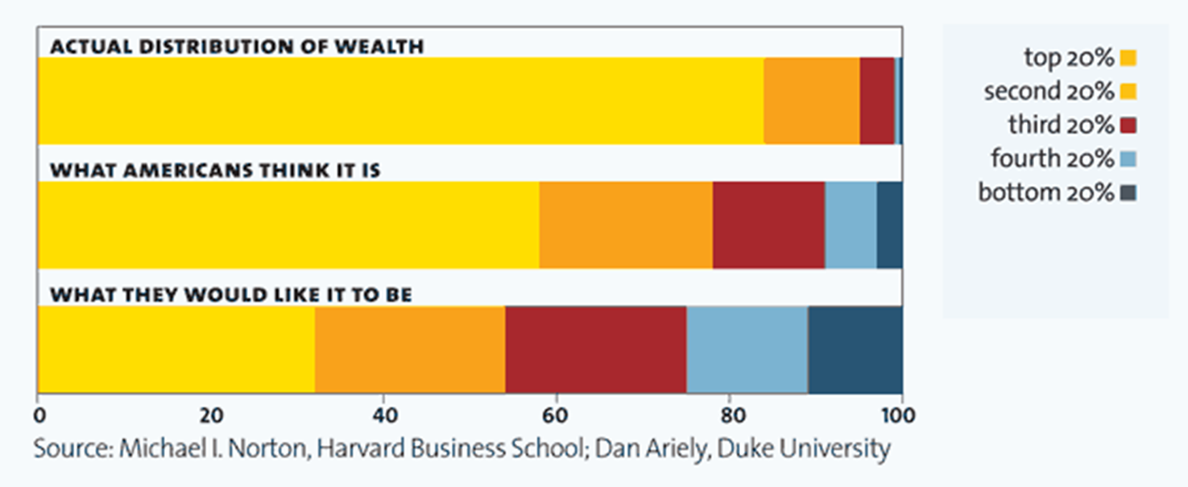
2005 Survey of 5000 Americans A Harvard business professors and a behavioral economist recently asked more than 5,000 Americans how they thought wealth is distributed in the United States. Most thought that it’s more balanced than it actually is. Asked to choose their ideal distribution of wealth, 92% picked one that was even more equitable.

